Slide 1
Relay Instructions
Set-Reset
© 2021 John Sefcovic.

Slide 2
Relay Ladder Logic
SET OUTPUT LATCH
TAG
-( S )-
The Set Output instruction will be set to a LOGIC '1' when there is a complete left to right path of true input instructions. Else, a logic '0' is stored in memory.
The output will remain SET or ON if the left to right continuity of the conditional inputs is lost.
Once the output is set to ON, it will remain ON even if the rung then goes false, a Set Output is retentive.

Slide 3
Relay Ladder Logic
RESET OUTPUT UNLATCH
TAG
-( R )-
The Reset Output instruction will turn OFF the output set that has the same reference address as the Reset Output instruction.
If both the Set Output and Reset Output networks are true, the effect will be that the output will never turn ON or will always be ON.

Slide 4
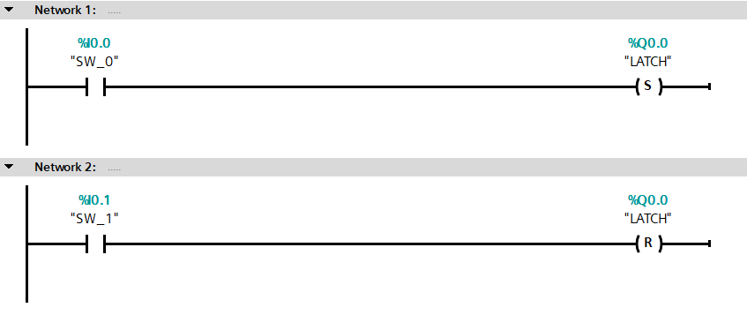
Relay Ladder Logic
When SW_0 transitions from False to True the LATCH output turns On and will remain On when the switch returns to False.
When SW_1 transitions from False to True the LATCH output turns Off.
Note: the switch is returned to False.

Slide 5
Relay Ladder Logic
Set Instruction Advantages
Acts as “last state” output, if power is lost to the programmable controller, when power is restored the outputs are restored to the state they were in before power loss.
Networks where the conditional input states are “pulsed” and not maintained for the entire duration of while the network is to be true.
For “single step” function where conditional input states which makes the network true are pulsed.
A “resume” when production is paused.
Notice the last three examples are a sub-functions of the “last state” capabilities of the instruction.

Slide 6

Relay Ladder Logic
Latch Instruction Disadvantages
All condition which will make the network go false must be accounted for in the Unlatch Output rung.
Machine or process must have logic programmed to “reset”, cycling power will not turn off errant latched outputs.
Outputs which may need to be off before restarting machine or process must be accounted for in program logic.
USE SET – RESET INSTRUCTIONS WITH CAUTION.

Slide 7
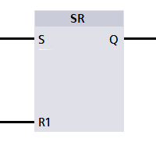
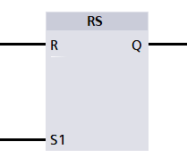
Relay Ladder Logic
SET – RESET INSTRUCTIONS
TAG
TAG
The Set-Reset or Reset-Set instructions have inputs to Set or Reset the assigned Output.
The Tag is the Q output.

Slide 8
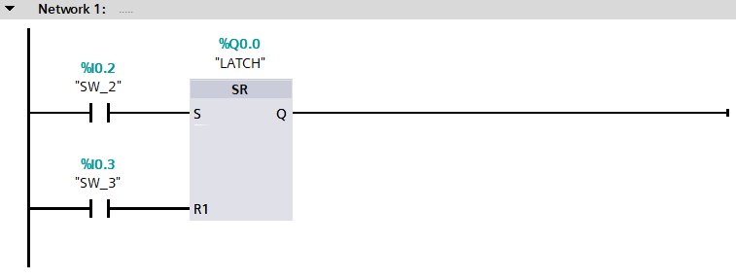

Relay Ladder Logic
When SW_0 transitions from False to True the LATCH output turns On and will remain On when the switch returns to False.
When SW_1 transitions from False to True the LATCH output turns Off.
Note: the switch is returned to False.

Slide 9
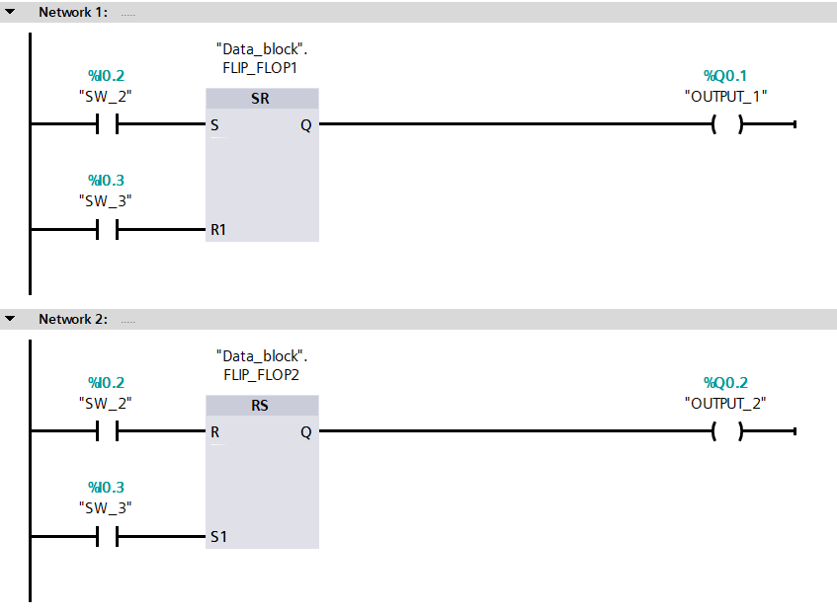
Relay Ladder Logic
The Set-Reset and Reset-Set instructions are commonly used to create a “flip-flop” logic.
When switch SW_2 transitions OUTPUT_1 is turned On and OUTPUT_2 is turned Off.
When switch SW_3 transitions the outputs “flip-flop.” OUTPUT_1 is turned Off and OUTPUT_2 is turned On.
A Data Block for the Set-Reset and Reset-Set instruction has been created for their Q Outputs to control the other Outputs.
Additional input conditions before the outputs may be required, such as, ENABLED or PART IN POSITION.

